Slide 1

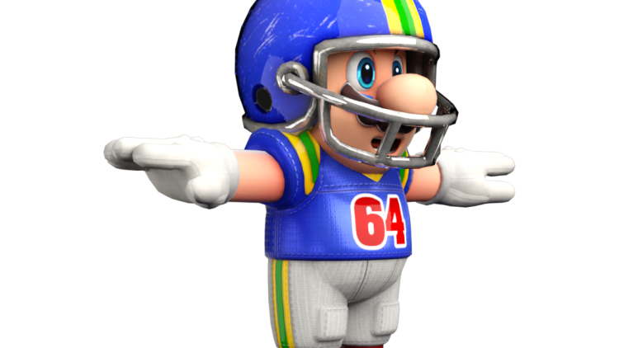

Football I
Produced by Dr. Mario | UNC STOR 390

Slide 2
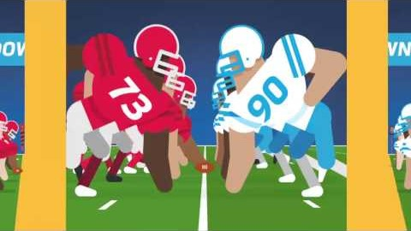
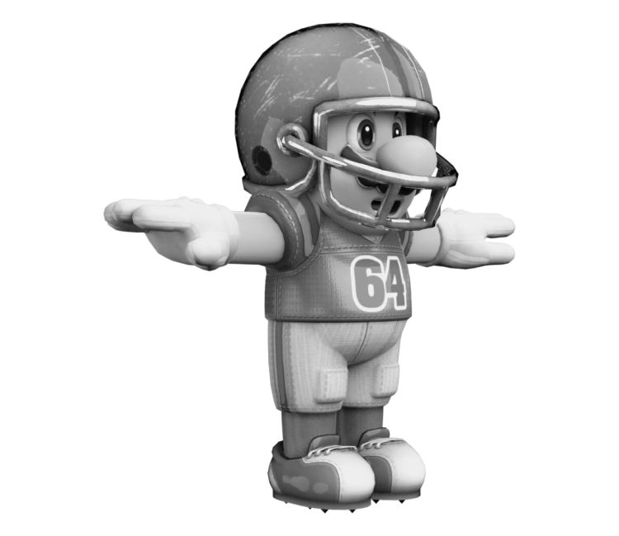
Overview of Football

Slide 3
What Makes Teams Win
Two Ways Offense Gains Yards
Passing
Rushing
Analysis by Bud Goode
Statistician from the 1960s
Passing YDS and Rushing YDS Not Effective
Showed YDS/ATT Good Predictors of Success
Measures of Efficiency are Better Than Counts
Both Passing and Rushing Attempts Use Up a Down
Downs in Football are Important Resources
YDS = Yards
ATT = Attempt

Slide 4
What Makes Teams Win
Scoring Margin for a Team
Related to the Spread
Formula
Positive Margin = Team Won
Negative Margin = Team Lost
Offensive Predictors of the Scoring Magin
Passing YDS/ATT
Rushing YDS/ATT
TOs Committed
PTS = Points
YDS = Yards
ATT = Attempt
TO = Turnover
$$Scoring Margin=PTS For −PTS Against$$

Slide 5
What Makes Teams Win
Defensive Predictors of the Scoring Margin
Passing YDS/ATT Allowed
Rushing YDS/ATT Allowed
Defensive TOs Caused
Differential Predictors of the Scoring Margin
Difference Between PEN
Difference Between Return TDs (Off Fumbles,
Interceptions, Kickoffs, and Punts)
YDS = Yards
ATT = Attempts
TO = Turnover
PEN = Penalty
TD = Touchdown

Slide 6
What Makes Teams Win
Regression on the Team Level
Covers 2003 – 2006 Seasons
All Predictors are Significant Except the Intercept
RSQ of 0.87
Standard Error of 35
Approximately 95% of the Time, the True Scoring Margin
Would Be Within 70 Points
Interesting Insight
Coefficients for Passing Efficiency Triple Coefficients for
Defensive Efficiency
Extra Passing YDS/ATT Worth 61.67 PTS (+3.85 PTS/G)
Extra Rushing YDS/ATT Worth 26.44 PTS (+1.65 PTS/G)
What is the Problem with This Interpretation?
PTS = Points
YDS = Yards
ATT = Attempts
G = Games
Based on 16
Game Season

Slide 7
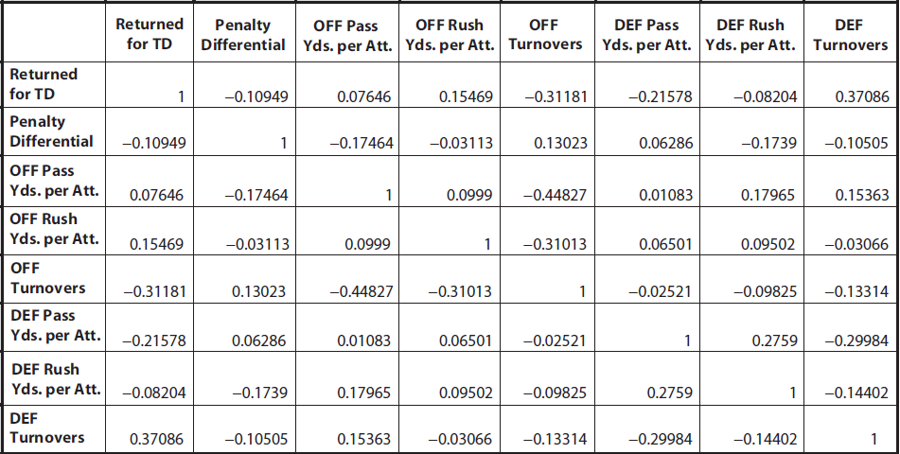
What Makes Teams Win
Correlation Matrix of Predictors

Slide 8
What Makes Teams Win
Modified Regressions for Scoring Margin
Regression Based ONLY on Passing Info (RSQ = 0.7)
Regression Based ONLY on Rushing Info (RSQ = 0.06)
Impact of Turnovers
Offensive TOs Worth 3.7 Points
Defensive TOs Worth 3.4 Points
Overall, TO Worth Approximately 3.55 Points
TO = Turnover

Slide 9
What Makes Teams Win
Relationship Between Passing and Rushing Stats
Correlation of 0.10 Between Passing YDS/ATT and
Rushing YDS/ATT
Many Believe Rushing Improves the Passing
Contradicts the Actual Seasonal Data
Why Low Correlation? Possibly Due to Payroll Decisions
YDS = Yards
ATT = Attempt

Slide 10

Final Inspiration
If you don’t remember if you played football, you probably played football.
- Mahatma Mario

